Slide 1
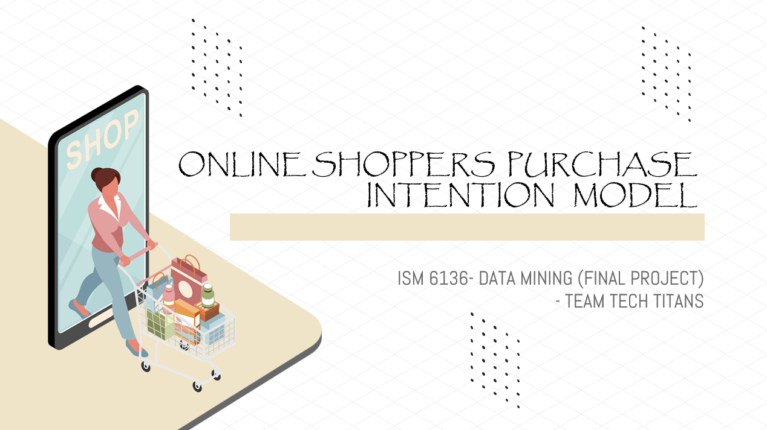

Slide 2
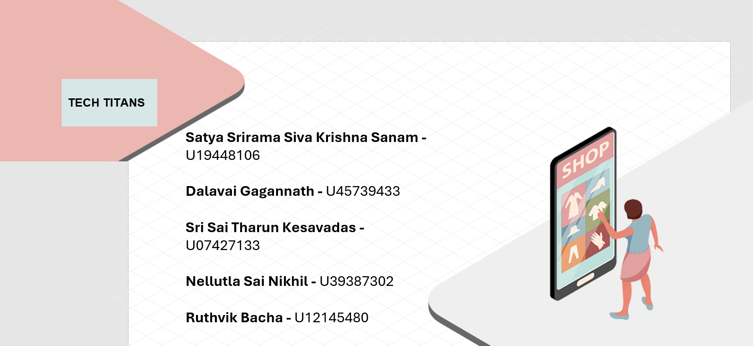

Slide 3
CONTENTS
INTRODUCTION
BUSINESS PROBLEM
EXISTING SOLUTION
METHODOLOGY
MODELLING TECHNIQUES
MODEL SELECTION
FUTURE SCOPE

Slide 4


INTRODUCTION
Why Online Shoppers dataset?
Online businesses find it very valuable to be able to foresee the purchase intentions of their customers in the fast-paced world of e-commerce.
To predict whether or not a potential consumer will make a purchase by utilizing data and machine learning concepts.
Our goal is to give e-commerce platforms predictive insights through user activity analysis that they can utilize to improve user experiences and increase revenue.

Slide 5
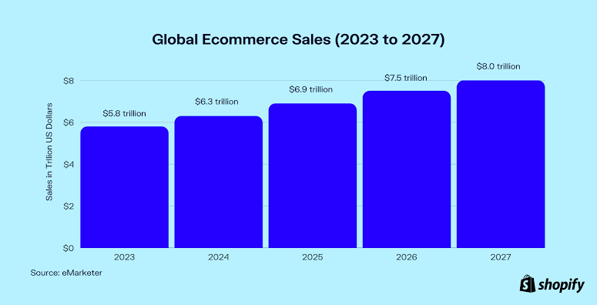
Statistics

Slide 6

BUSINESS PROBLEM
The primary business issue is the e-commerce company's low sales conversion rates.
The lack of personalization and predictive insights limits the effectiveness of resource allocation.
Can we forecast a user's likelihood of making a purchase from clickstream and session data when they visit an e-commerce website?

Slide 7
EXISTING SOLUTION & NECESSITY FOR A NEW MODEL
According to the research done, Link to the Paper, they have used the Random Forest model and Naïve Bayes model
The main drawback is that, no other models were explored in this paper
In our project, we were able to achieve better Predictive model having higher F1-score, using Ensemble techniques.

Slide 8
METHODOLOGY
Our approach to anticipating client purchase intents is a well-structured procedure that adheres to industry best practices in data science and machine learning
Which involves data preprocessing, feature engineering, and model selection. We'll train and assess multiple machine learning models, as well as fine-tune hyperparameters.
To forecast client purchase intentions, the best-performing model will be chosen which will provide a real-time individualized user experience after deployment and can be enhanced for customer segmentation, inventory management, fraud detection, and market research applications.

Slide 9

Understanding Source data
What source?
UCI ML repository: An open-source repository which provides a
diverse range of datasets for Analysis
Online Shoppers Purchase Intention Data: Dataset collected by C.
Sakar and Yomi Kastro, Turkey.
What type is our source data?
Binary classification data , with a target column of
cardinality 2
Target contains 2 possible outcomes
Revenue False: Customer doesn’t make a purchase, hence no revenue
Revenue True: Customer makes a purchase, hence revenue will be generated

Slide 10
Attribute information
Feature Name | Feature Description
Administrative | Number of pages visited by the visitor about account management
Informational | Number of pages visited by the visitor about Web site, communication and address information of the shopping site
Product related | Number of pages visited by visitor about product related pages
Bounce rate | Average bounce rate value of the pages visited by the visitor
Exit rate | Average exit rate value of the pages visited by the visitor
Page value | Average page value of the pages visited by the visitor
Visitor Type | Whether the customer is new or returning
Weekend | Whether it’s weekday or weekend
Revenue | Closeness of the site visiting time to a special day

Slide 11
Data imbalance
12330
1908
10422
TOTAL records
MAJORITY CLASS
MINORITY class
Both the classes combined
Revenue- False
Revenue- True

Slide 12


Slide 13
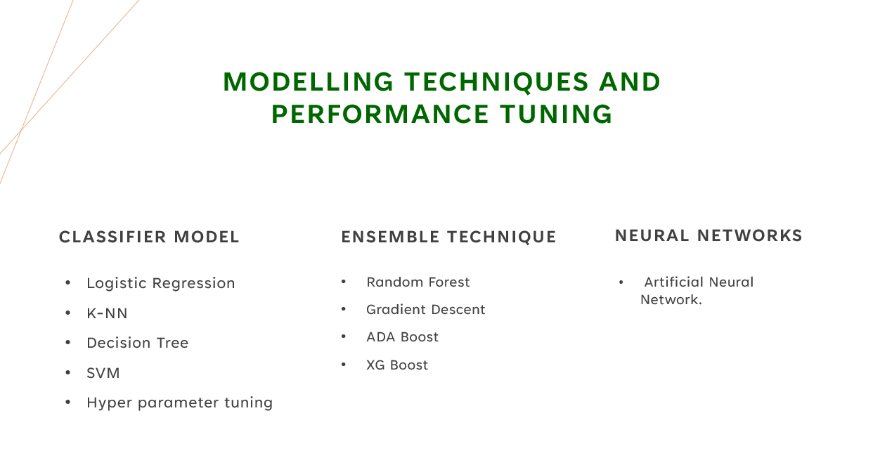

Slide 14
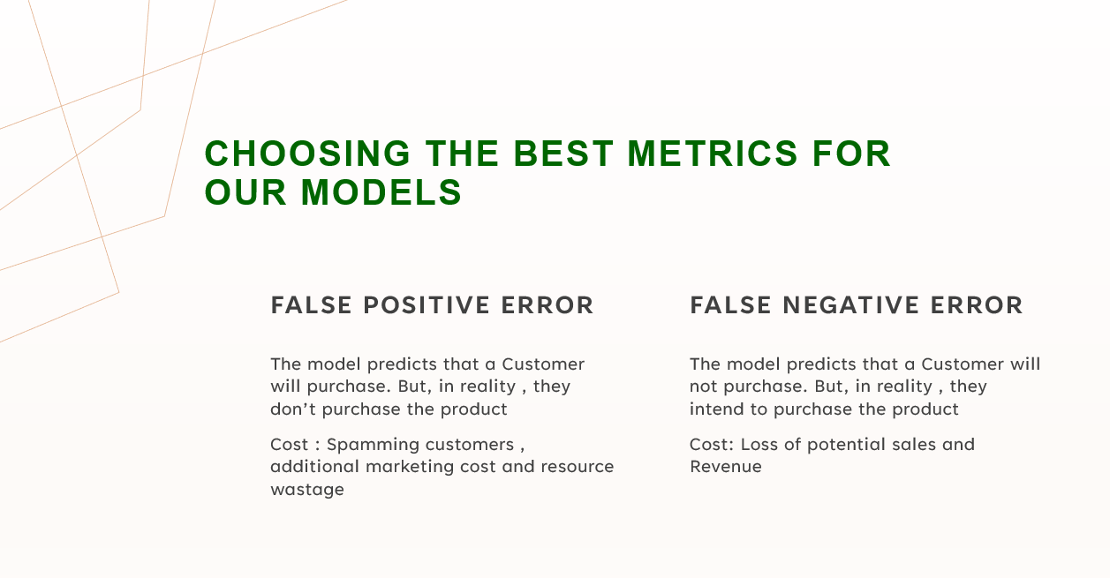

Slide 15
Graphs- Bar plot of F1 Score for various models

Slide 16
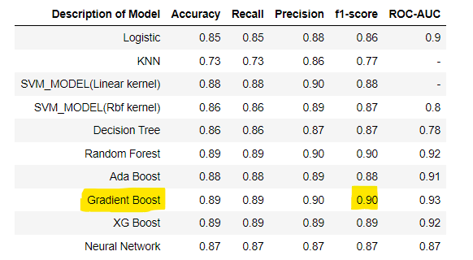
MODEL SELECTION
Best Model
Gradient Boost seems to be the best model for our dataset.
Best F1-Score
F1-score = 0.90

Slide 17
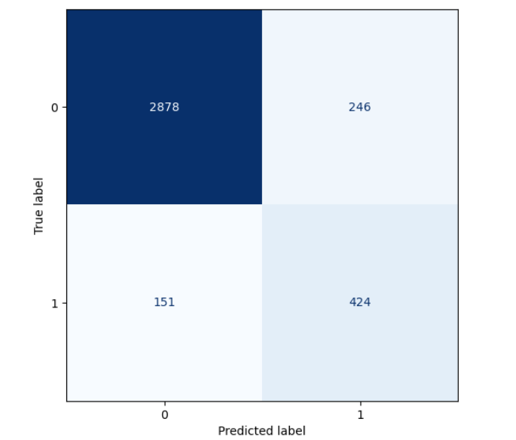
Confusion Matrix
True Positives- 424
False Positives- 246
False Negatives-151
True Negatives- 2878

Slide 18

FUTURE SCOPE
The predictive model for client purchase intent can be integrated into the product suggestion system on the e-commerce website.
Further research can be conducted to discover whether recommending products based on consumer intents promotes higher sales.

Slide 19

FUTURE SCOPE- Contd.
For example, offering discounts to clients who have low buy intent may motivate them to make a purchase.
Additionally, improved hyperparameter optimization and the exploration of reinforcement learning approaches for comparison could be pursued.
Furthermore, future study may involve using larger datasets to evaluate model performance.

Slide 20
Thank you!
-
-Tech Titans

